Slide 1
PID Line Follower Robot
Group – 2(A2)
4NM20EE032 | Kanzal Haq A |  | 4NM20EE038 | M Satwik Rai
4NM20EE022 | Disha Ravi

Slide 2
Introduction
A reprogrammable, multifunction, manipulator designed for moving materials
Can perform desired tasks in any environment without continuous human guidance
Autonomous robot which can follow either a black or white line that is drawn on the surface consisting of a contrasting color
Proportional, Integral & Derivative functions to improve the movement of the robot
Atmega Microcontroller will be used to perform and implement PID algorithms to control the speed of the motors steering the robot
Applications in the field of Medicine, Automation and Space Application

Slide 3
Objectives
To design an autonomous robot to follow the black line and increase the accuracy of the tracking the line
To study and observe the working of sensors, motors, PID controller etc
To implement the PID algorithm to test and tune the PID control to gain better accuracy and speed
To design a line follower robot with PID controller and compare it with other line follower

Slide 4
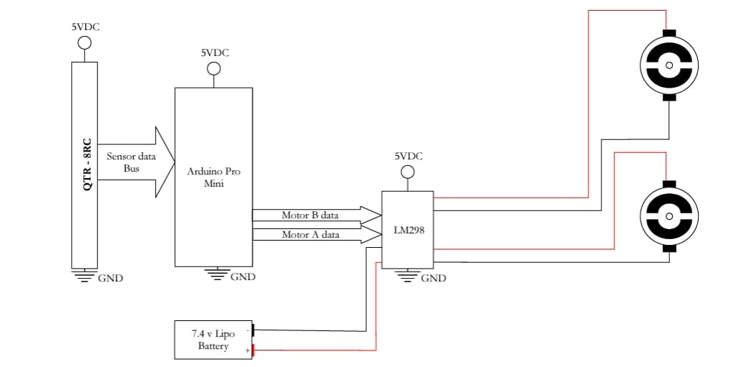
Project Description

Slide 5
Project Implementation
Applied in military to reducing the number of casualties which occur during military actions has already been prioritized
Uses robots for locating and destroying mines on land and in water, spying on enemies and entering enemy bases for gathering information
They use robots which are used for exploration
Robots can carry cameras and other instruments through which they can collect information and send back for processing to their human operators
The continuous development of autonomous robots increases our ability to explore universe

Slide 6
Results and Discussion
The robot was successfully able to follow the line for K_{p} equal to 0.45 and K_{d} equal to 0.3
Output was taken under a certain lighting condition and a similar response might not be obtained for a different ambient lighting condition
Sensor would need to be calibrated to produce the perfect output.
The parameters of the controller were designed using the manual tuning method
Limitations in the hardware (Motor and Sensors), perfect control was not obtained
Response of the system was better as compared to that of a simple open loop controller

Slide 7
Conclusion
Future Scope of this project involves method for tuning the PID controller
This can be done by finding out the transfer function of the process and tuning the value of the proportional gain up to the extent when the output starts oscillating
Noting down the gain and time period of oscillations, the value of the integral and derivative gain can also be determined

Slide 8
References
Textbooks
none
Technical Papers
none
Web materials
ATMEGA DATASHEET
Arduino.cc

Slide 9
Thank You

